Slide 1
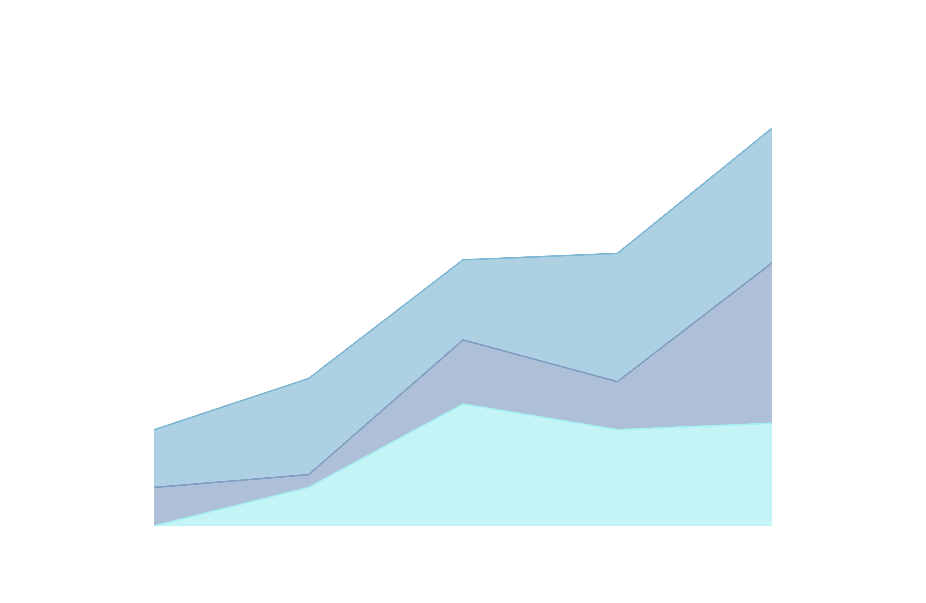
DATA VISTA:
SALES DATA ANALYSIS AND VISUALIZATION
MENTOR- JAYA DARSHANA

Slide 2


Objective
To analyze and visualize sales data trends, patterns, and anomalies to provide actionable insights for optimizing sales performance, enhancing customer targeting strategies, and improving overall business decision-making.

Slide 3
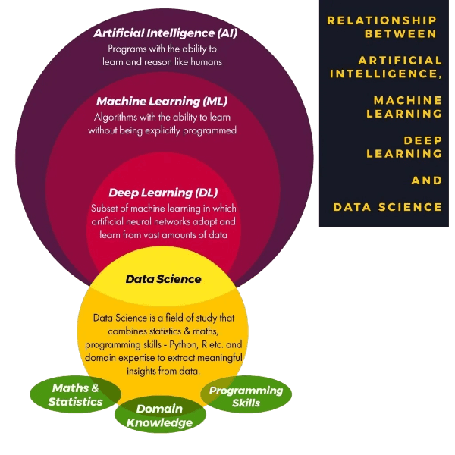
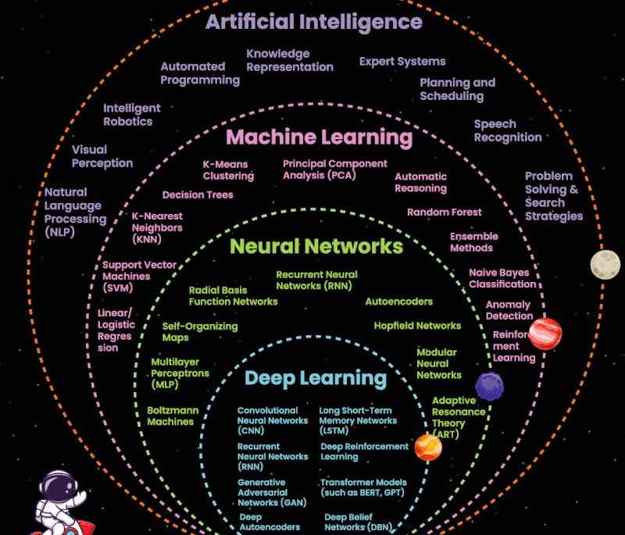
AI vs ML vs DL vs Data Science

Slide 4

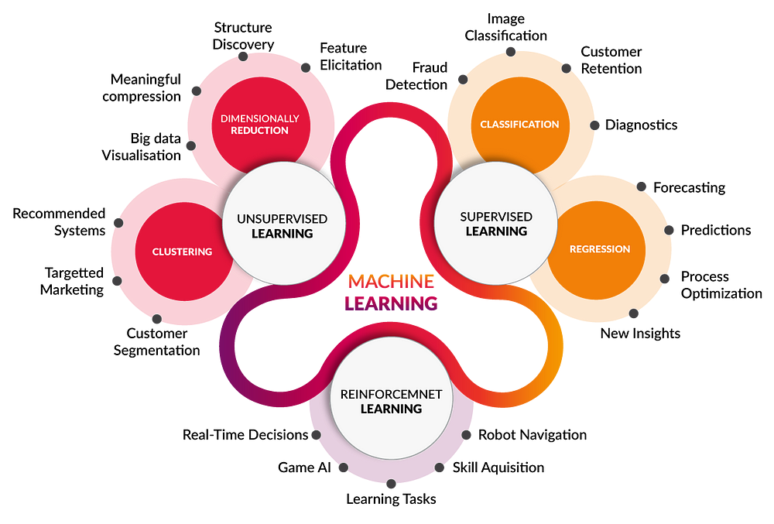
Machine Learning
Machine Learning (ML) is a subset of AI, enabling machines to learn from data and improve performance over time.

Slide 5
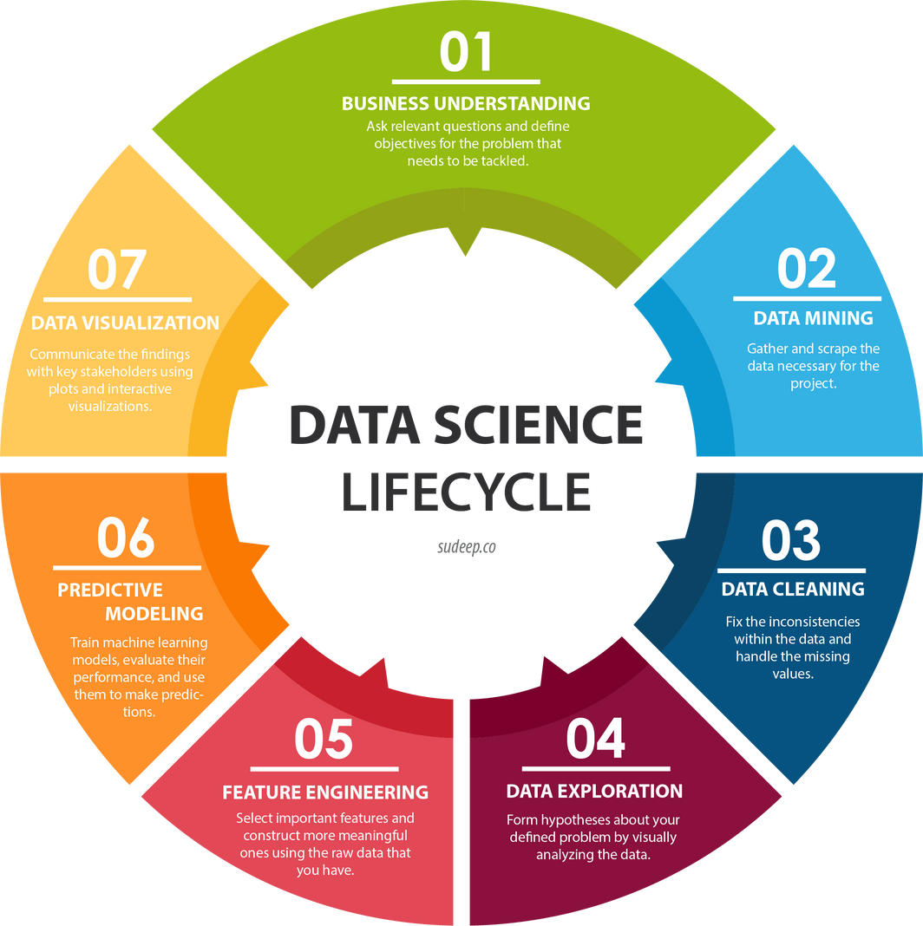
What is Data Science?
Data science is an interdisciplinary field that uses scientific methods, algorithms, processes, and systems to extract knowledge and insights from structured and unstructured data for decision-making and predictions.

Slide 6
Project Workflow
Random forest
Data Cleaning & Transformation
Data Collection
ML Model Building
Data Analysis
Model Deployment
Visualizations
Linear Regresssion

Slide 7
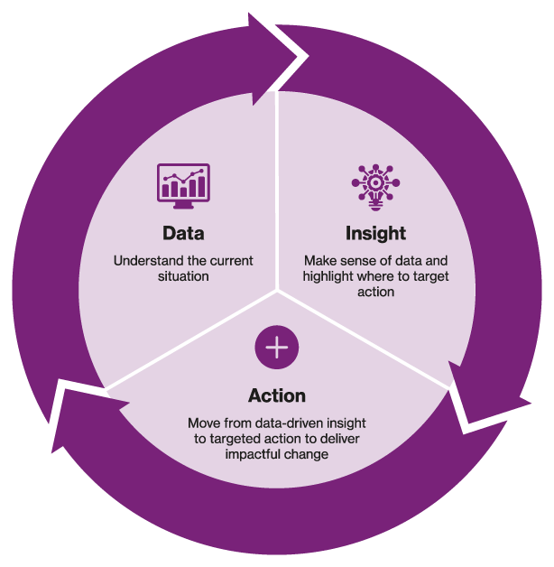
Data Insights
Overview of Key Metrics
Important KPIs
(Key Performance Indicators):
Total Sales Revenue
Year-over-Year (YoY) Growth Rate
Month-over-Month (MoM) Growth Rate
Average Order Value (AOV)
Customer Lifetime Value (CLV)
Sales by Region
Sales by Product Category
Gross Profit Margin
Conversion Rate
Customer Retention Rate

Slide 8
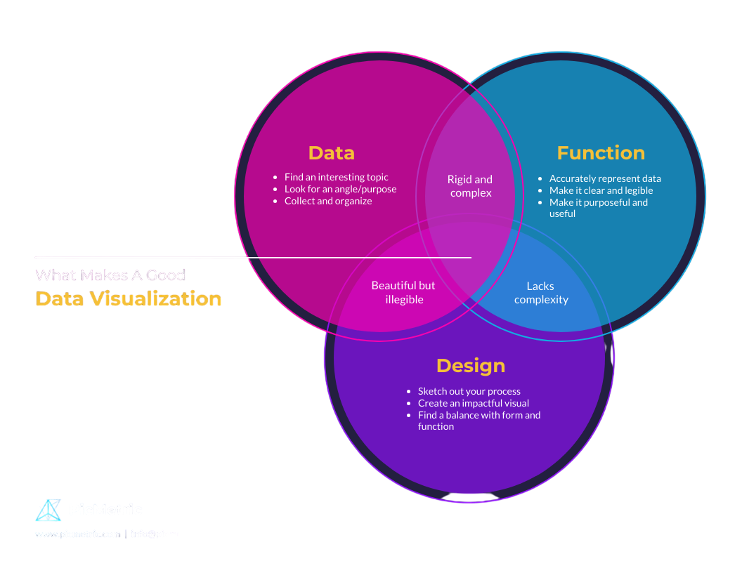
Data Visualization
Data visualization transforms complex data into clear visuals, like charts, enhancing decision-making and understanding across various sectors.

Slide 9
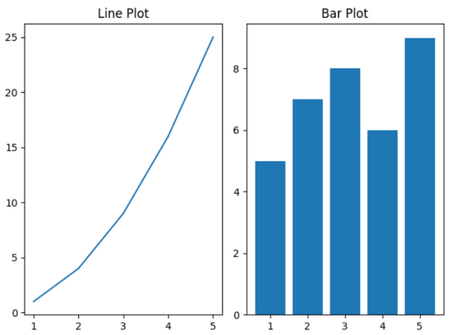
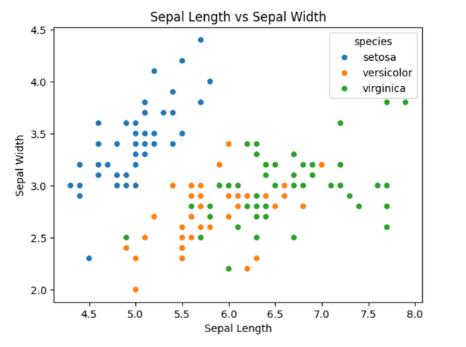
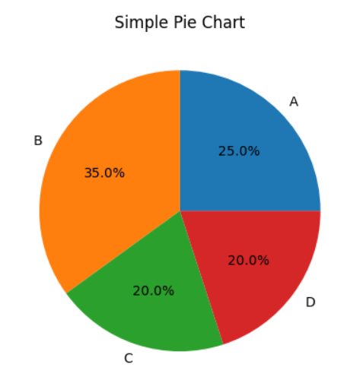
Trends and Patterns
Line Plot: Shows trends or changes over time for continuous data. Useful for tracking progress (e.g., monthly sales).
Bar Plot: Compares values across categories using bars. Ideal for discrete data (e.g., product sales comparison).
Scatter Plot: It uses points to represent values of two variables, showing the relationship or correlation between them.
Pie Chart: It represents data as a circular graph divided into slices, where each slice shows a proportion of the whole.

Slide 10
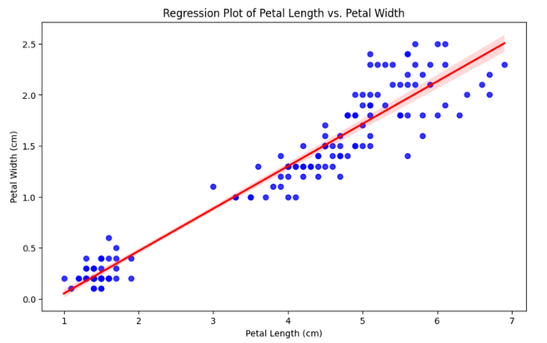
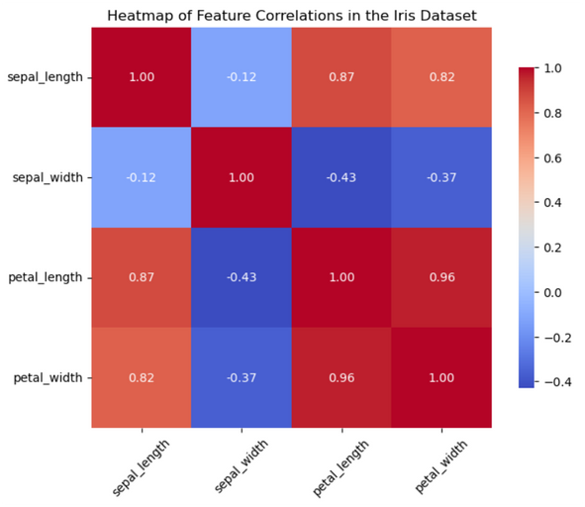
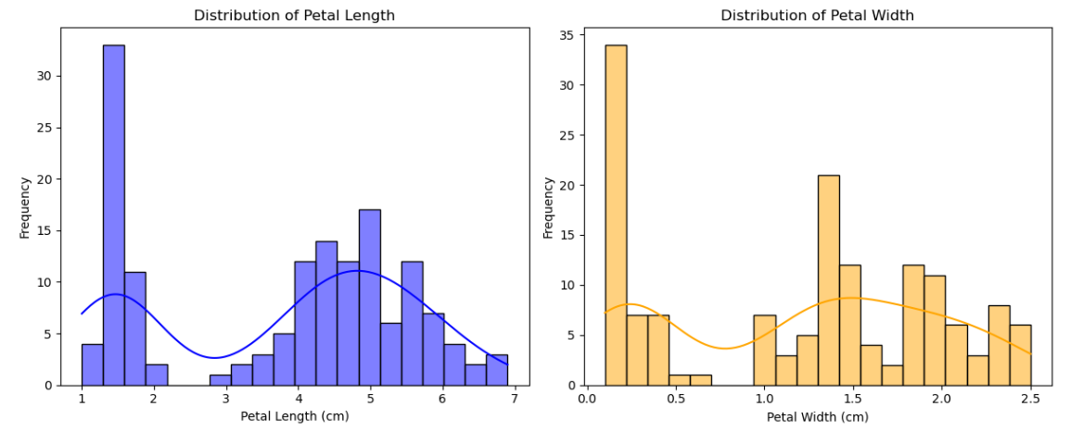
Trends and Patterns
Regression Plot: This Graph represents how a regression model fits a dataset to predict a dependent variable based on one or more independent variables.
Heat Map: It’s a data visualization technique that uses color to represent the magnitude or intensity of values within a dataset.
Distribution Plot: It shows how data values are spread across a range, helping visualize the frequency of different values in a dataset.

Slide 11
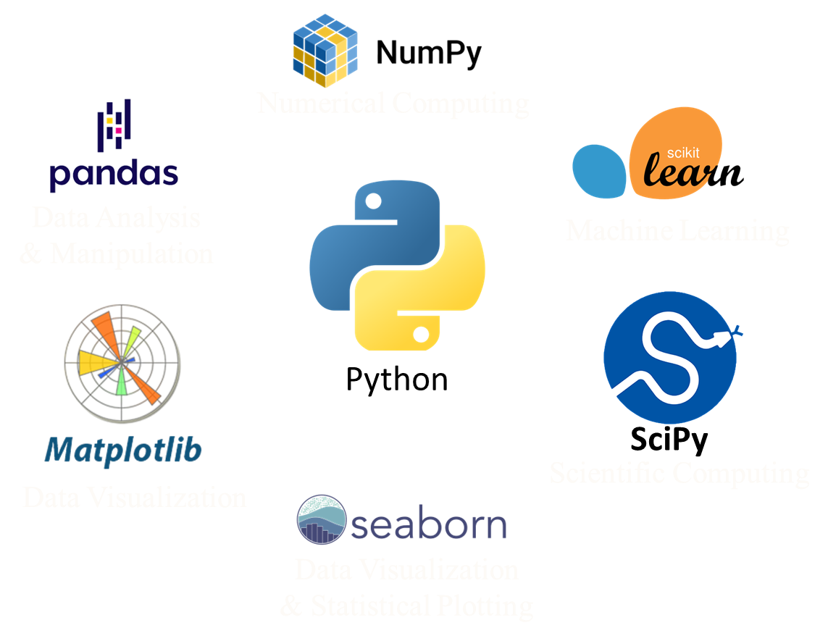
Tools and Libraries
Scikit-learn Components:
1. Model Selection
train_test_split
2. Preprocessing
LabelEncoder
StandardScaler
OneHotEncoder
SimpleImputer
3. Metrics
mean_squared_error
4. Estimators
RandomForestRegressor
RandomForestClassifier
5. Feature Engineering
ColumnTransformer
6. Pipelines
Pipeline

Slide 12
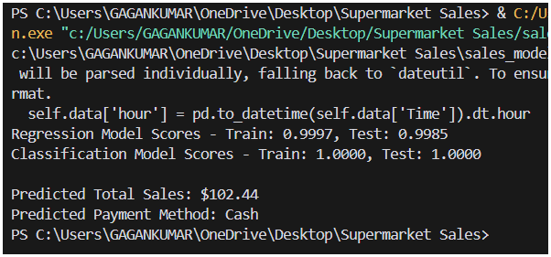
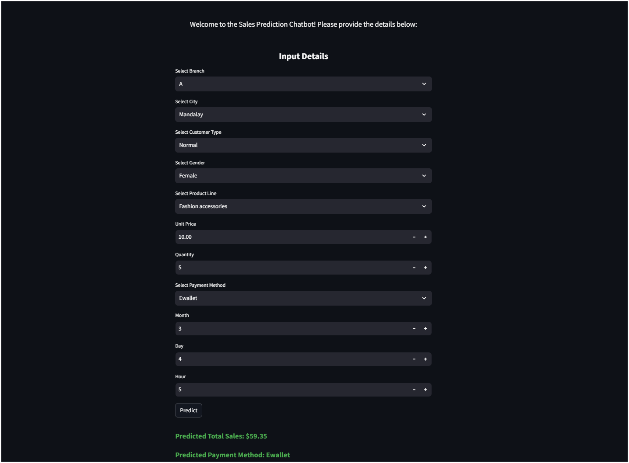

Tools and Libraries
Sales
Prediction
Chatbot
Simplifies building
data-driven web apps.

Slide 13

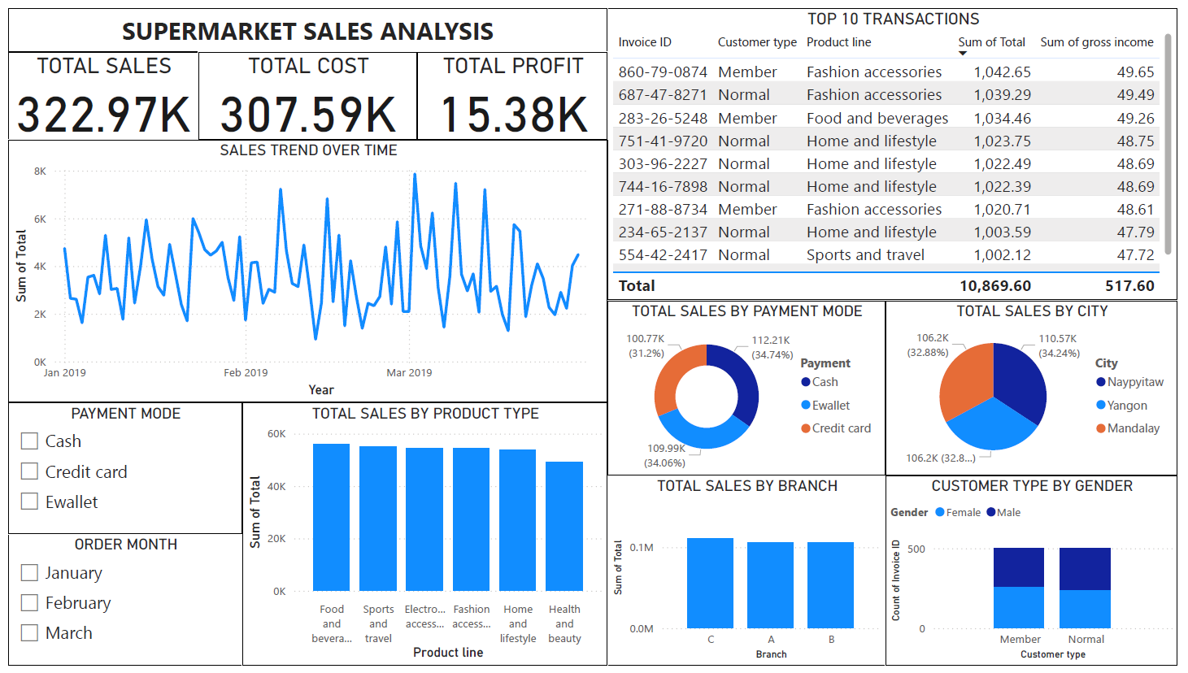
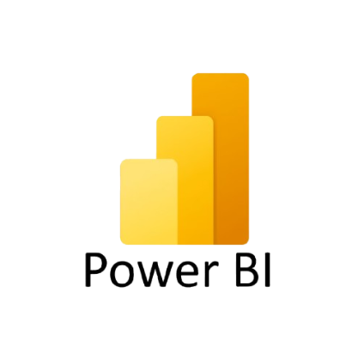


Tools and Libraries
Tableau

Slide 14
THANK YOU !

